Slide 1
Gloucestershire Coronavirus Emergency Response Fund
Impact Report
July 2020

Slide 2
Talitha Nelson GCF CEO – three transformational months
“On the 16th of March I sent a paper to the Board proposing how we should respond to Covid-19. My first communication to the outside world started with a CEO letter a day later.
In the first two weeks, setting up a crisis fund appeal and grant-making process, (with the guidance of our network) we were the only funders in Gloucestershire responding. We set the pace and stepped up our third sector leadership role. I knew we needed to create hope and put our arms around the county with positive messages and action.
We set an ambitious appeal target of £50K – donations to the appeal now stand at nearly £800k. Funding achievements fuelled a pace on grantmaking at an unprecedented rate, overtaking the grants the foundation has previously awarded in a year in just 12 weeks.
This has been a transformational time, one of adapting, learning, stretching, growing in confidence, repositioning and also increased responsibility. Both with the increased funds we have to manage and our leadership role in the county.

Slide 3
Gloucestershire Coronavirus Emergency Appeal
£790,828 raised in 100 days
Supporters include:
National Emergencies Trust (NET), Thirty Percy, The Julia and Hans Rausing Trust, The Hayward Waite Charitable Fund, The Gloucestershire Disability Fund, The CHK Foundation and The Honourable Company of Gloucestershire and other generous individual donors.

Slide 4
Gloucestershire Coronavirus Emergency Response Fund
Within three months, we have awarded
113 grants totalling
£382,599
Supporting charities, community groups and voluntary organisations working in Gloucestershire to help the county’s most vulnerable people and communities.

Slide 5
Our grants in numbers
109 separate groups supported
Average grant size £3,385
Over 100,000 estimated beneficiaries
161 applications received
97 grants supporting health and wellbeing
48 grants helping to provide food

Slide 6
Where did we award grants?

Slide 7
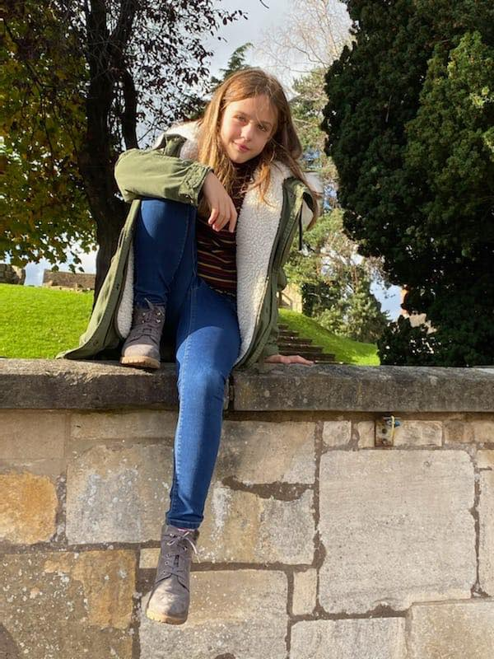
What is the impact?
Gloucestershire Deaf Association
£5,000 towards the costs of providing online support, communications and sign language translators to reduce isolation, worry and confusion
A regular at the Gloucester Deaf Club (GDC), a BSL social club, admitted to GDA colleagues that he had been missing coming to the club and had been struggling with the lack of communication in his first language, BSL as his wife and family do not sign. GDA arranged for a volunteer to meet with him, socially distanced, on his driveway, where they enjoyed a conversation in BSL. This was such a relief and a success for the gentleman, that he has now requested more regular chats.
“This simple act of support has meant that this person is feeling less isolated. He is now able to converse with someone in his first language. He is able to discuss and understand matters that he has been concerned about. In a society where we are encouraged to talk for the good of our emotional wellbeing, sadly for people whose first language is BSL, that is not always possible, which is why this support has been vital for the wellbeing of our local BSL community in Gloucestershire”
“The reassurance of seeing familiar faces is vital to our youth clubs and young adults – in response to her weekly zoom invite one young adult recently replied “thanks I can’t wait to see you guys because you are my life!” This is a stark reminder of how isolated Allsorts members are, and without this weekly opportunity to see her friends, this young adult would have no social contact with anyone other than her parents.” Allsorts Gloucestershire
Analysis of evaluation reports submitted so far by grantees identified the following common impact themes:
Improved mental health (18 grants)
Reduced isolation and loneliness (14 grants)
Improved physical wellbeing (7 grants)
Providing food and/or shelter (12 grants)
Increased confidence (4 grants)
Feeling valued and accepted (2 grants)
Young Gloucestershire
A grant of £5,000 enabled staff to be rapidly redeployed and work flexibly to meet the needs of young people as the crisis unfolded enabling services to be adapted and more than 270 care packages to be delivered to vulnerable young people in Gloucestershire.
“At the start of the week I received a phone call from a parent we have been supporting with care packages. Her 10-year-old daughter’s mental health had been quickly deteriorating and understandably mum was quite panicked. This message just goes to show how a small gesture can have a huge impact on the people we support.”

Slide 8
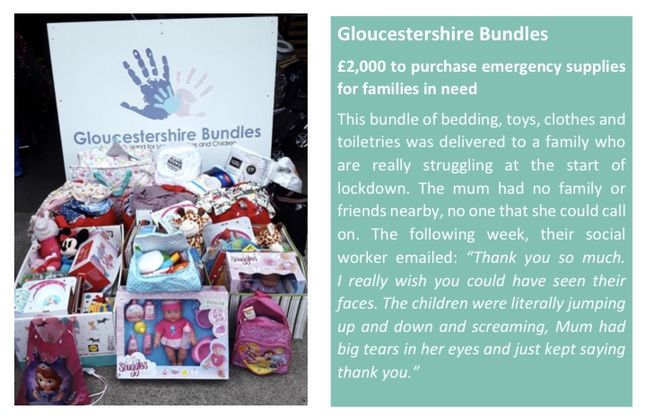
How have we helped?
“The difference this grant has made has been significant. It has enabled children and parents to continue to thrive by meeting both their basic needs and also offering, stimulation, maintaining learning opportunities, bringing calm to complex emotions and households. It has supported the school's relationships with the children, enabled a positive experience for so many, during a negative and challenging period. Reduced fear and uncertainty, given structure and opportunity, reduced isolation, but above all it has given the children and families confidence that they are cared about, barriers can be overcome, they can continue to have aspirations, even during adversity.”
Lucinda Field, Kingsholm C of E School
We awarded a grant of £5,000 to Gloucestershire Counselling Service towards the provision of subsidised counselling sessions to meet a huge increase in need as a result of lockdown
Clients reported that during lockdown particularly, counselling has been: “a life raft, the only meaningful contact I have outside of my house, without which I don’t think I could survive lockdown”
GCS had spent our grant within 4 weeks providing 4 counselling sessions each to 56 people

Slide 9
Grant Snapshots
Thank you very much for this – it has made our day. This will make a huge difference to us at this really uncertain time when other funding has been lost or reduced and will enable us to offer remote support more widely when it is so needed.
Vikki, Inclusion Gloucestershire
“After a 12-hour shift in stifling PPE and under huge emotional strain, the ride home helps me face my family with a smile and helps me feel able to go back and do it all over again tomorrow” An ER nurse given a Gloucestershire Bike Project bike
We were pleased to support Music Works’ online programme for young people in Gloucestershire, helping them to feel less isolated during this time whilst also providing a platform for their amazing musical talents. Click HERE to see their fabulous Every Rainbow Drawn musical collaboration.

Slide 10
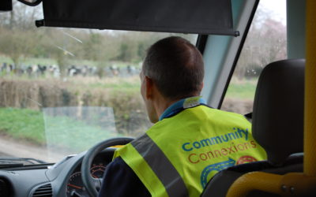
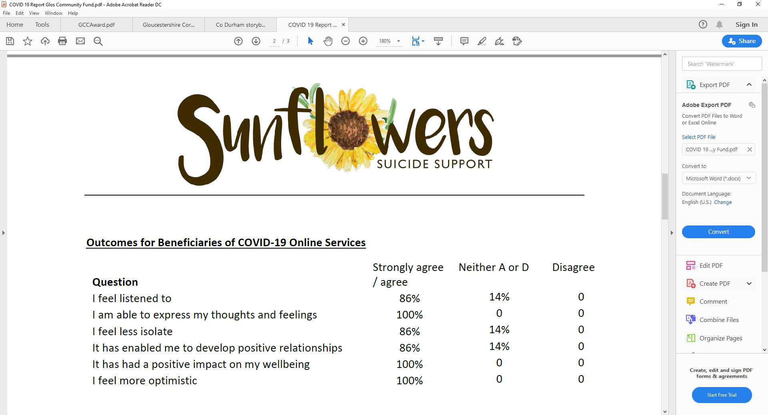
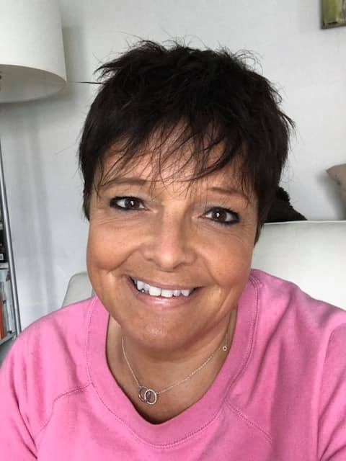
Grant Snapshots
Community Connexions
£2,000 to help them fund essential transport services to elderly people during lockdown. Getting people to doctors appointments, delivering prescriptions and food parcels and helping with shopping.
“Our service-users have asked us to continue journeys to supermarkets to buy their essentials. They cannot use family or friends to assist and have no transport of their own. They have been unable to book on-line shopping or have no access to the internet. Our service provides a life-line for them. The grant has been invaluable in providing essential services for the most vulnerable people in our communities. What would they have done if we had not been there to help?”
Sunflowers Suicide
Our grant of £2,900 has enabled them to recruit Andrea to provide video link counselling sessions to beneficiaries who have been bereaved by suspected suicide and are feeling especially isolated during this time. 8 people living in Gloucestershire were supported by this service and reported the outcomes below:
We are appreciative of the funding from GCF's emergency fund that has enabled us to be so flexible in these times.
WAM Youth, Winchcombe
We are already starting to see the effects fear and uncertainty are having on our beneficiaries. As part of our measuring and evaluation of our work, we ask beneficiaries for feedback on their mental health, it is no surprise that ratings are currently at an all-time low. However, financial assistance from the Foundation helps us continue supporting those whose mental health is being adversely affected by the current situation as well as increase our reach to those we have not supported before. The Door, Stroud
Andrea says: Counselling is my passion. There is nothing better than seeing the changes that people can make to improve their lives and for them to get to a happier place and to be able to cope better with their various issues.

Slide 11
What have we supported?

Slide 12
What have we supported?

Slide 13
A nimble and supportive approach to grantmaking
I couldn’t believe the incredibly fast response time - I know that it is called an Emergency Response Fund but, trust me, there are others out there who deem “emergency” to mean that they will let us know after their next trustees meeting in September…. Truly, thank you from all the Trustees of North Cotswold Community Awareness. We are bowled over by your generosity and professionalism. North Cotswold Community Awareness, Moreton in Marsh
Thank you so much for supporting us during this worrying time. The lead up to 'lockdown' felt like a tsunami was coming.... and we were all trying to brace ourselves for what was to come and desperate to not let down any of the young people who we had a duty of care for . Your kindness and calm manner was helpful and reassuring - it made us realise that we were not going to be alone on this journey. Thank You!!!! Tic Plus, Stroud
This has been a really positive experience for us. We found the Grant Manager responsive, empathetic and efficient. The process was quick from application, through the interactions with the grant team, to approval and receiving the funds. This enabled work to be undertaken quickly and prevented further escalation of need. The application form was straight-forward and we appreciated the flexibility shown by the Grants Team, as the needs we were experiencing were changing rapidly on a daily basis. There was no comparable situation to draw on, as the pandemic and subsequent lockdown has been a completely new challenge for us all. Friends of Kingsholm C of E School, Gloucester
On behalf of all small local charities, thanks for making this funding available and turning applications around so quickly. So much appreciated! Pam, Forest Pulse
The application process was simple and your rapid response was impressive. I wish more emergency funding schemes could work as quickly as you do - you clearly understand that emergency responses means that grants have to get out to organisations at high speed. Play Gloucestershire, Gloucester

Slide 14
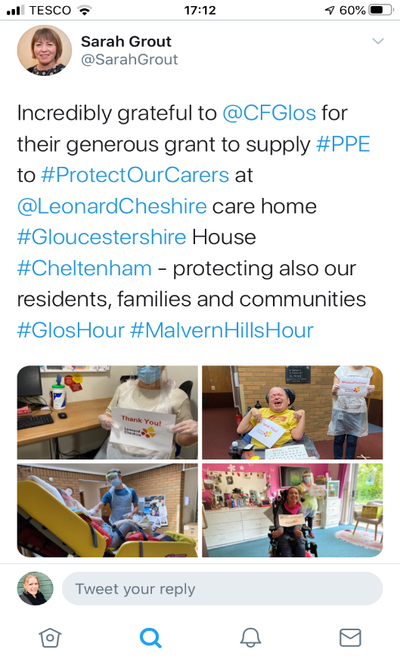
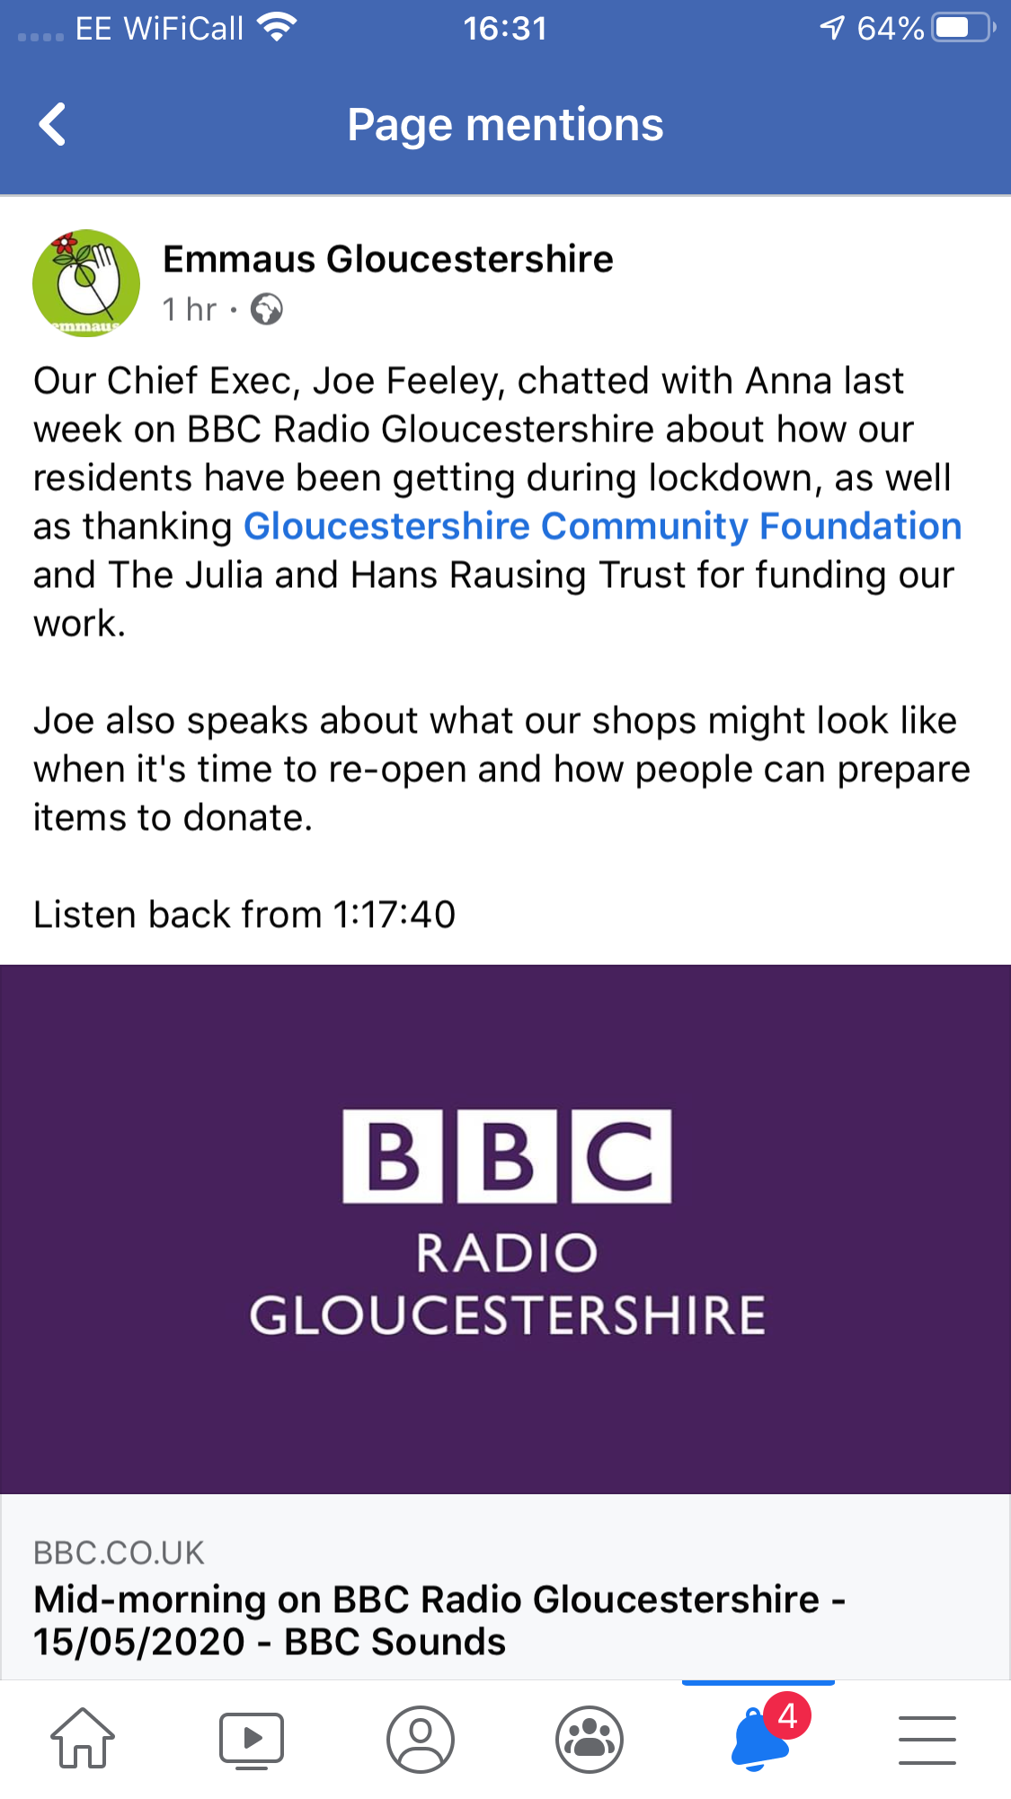
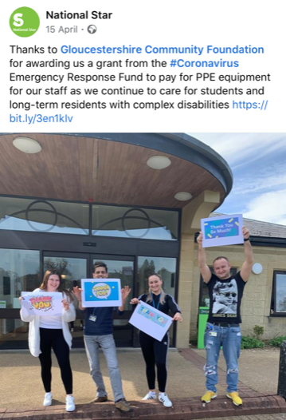
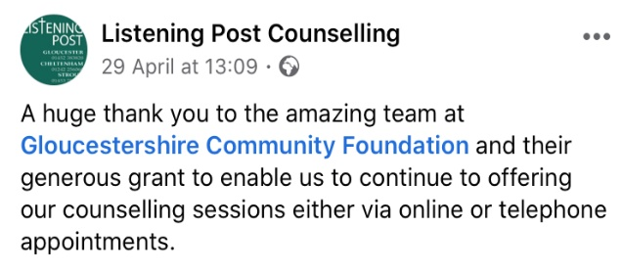
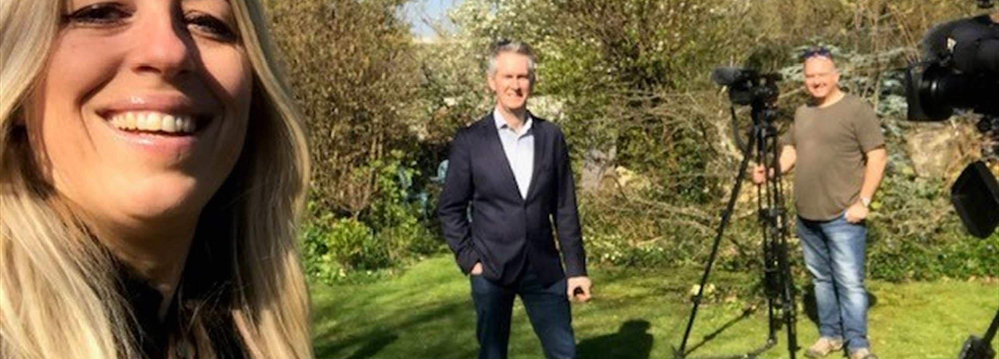
PR and Marketing Activity
Listen to Talitha on BBC Radio Gloucestershire,
Reflections on 100 days in lockdown
CLICK HERE
Post Views from 1000 - 1892
Engagement 20 likes to 53 likes
TV Interviews and mentions x 3
Radio Interviews x 10
Punchline article x 1
Western Daily Press mentions x 2
Twitter feed
360 Tweets
Followers from 280 to 658
Following 659 - 1182
Steve Knibbs BBC News, Interviewing Talitha for Points West
Followers increased to 130
Tagged posts 8 from none previously

Slide 15
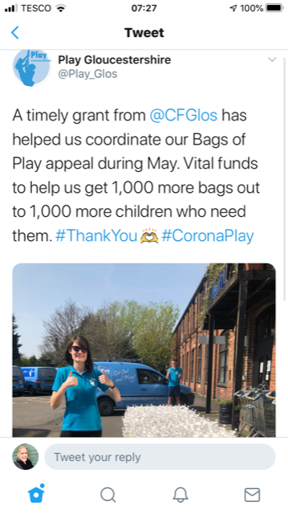
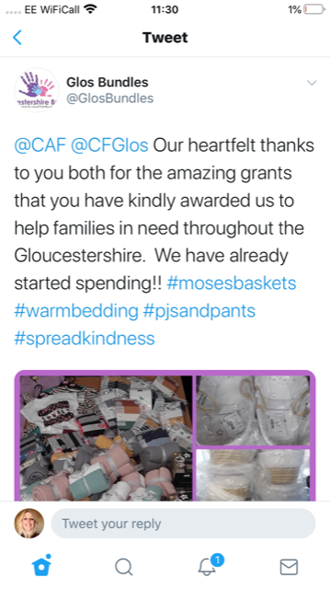
Marketing engagement across the third sector

Slide 16
Collaboration: Gloucestershire Funders
The crisis has brought organisations closer together with a common purpose. GCF played a key role in the inception of the Gloucestershire Funders
Gloucestershire Funders is a new collaboration between six charitable foundations and organisations who can provide funding for charities, groups, people and activities, in Gloucestershire. We have come together to support the county during the COVID-19 pandemic.
The Gloucestershire Funders, in alphabetical order, are:
Barnwood Trust
Create Gloucestershire
Gloucestershire Community Foundation
National Benevolent Charity
Police and Crime Commissioner’s Office
Thirty Percy Foundation
We are also in contact with the VCS Alliance, the Local Enterprise Partnership and the District and County Councils as well as other charitable funders in Gloucestershire, including Summerfield Charitable Trust, Gloucestershire Disability Fund, National Lottery Community Fund in Gloucestershire, St James’s Place Foundation, The Henry Smith Charity County Grants and The Honourable Company of Gloucestershire.
See full details as published in the VCSE Alliance newsletter: http://www.glosvcsalliance.org.uk/gloucestershire-funders/

Slide 17
Full List of Grants Awarded (1)
Organisation | Amount Awarded | Date Approved
Abbeyfield Tewkesbury Society Ltd | £5,000 | 28/05/2020
Age UK Gloucestershire | £4,478 | 19/06/2020
Alabare - Gloucestershire Homes for Veterans | £3,000.00 | 03/04/2020
Allsorts | £1,000.00 | 03/04/2020
Allsorts | £3,750.00 | 05/06/2020
Arkell Community Centre | £3,232.70 | 05/06/2020
Bledington Community Shop Limited | £325.00 | 01/05/2020
Brockworth Parish Council | £500.00 | 08/04/2020
Building Circles in Gloucestershire | £4,300.00 | 20/05/2020
Caring for Communities and People | £5,000.00 | 17/04/2020
Cheltenham Housing Aid Centre | £5,000.00 | 05/06/2020
Churn Neighbourhood Project, The | £5,000.00 | 01/04/2020
Organisation | Amount Awarded | Date Approved
Cinderford Artspace | £3,456.00 | 24/04/2020
Clean Slate Training and Employment | £2,000.00 | 01/05/2020
Community Connexions | £2,000.00 | 17/04/2020
Cotswold Counselling | £3,000.00 | 24/04/2020
Cotswold Friends | £5,000.00 | 03/04/2020
Creative Sustainability CIC | £5,000.00 | 24/04/2020
Crossroads Care Central & East Gloucestershire | £5,000.00 | 01/05/2020
Crossroads Care Forest of Dean | £1,000.00 | 24/04/2020
Cruse Bereavement Care Gloucestershire | £5,000.00 | 07/05/2020
Dean Radio | £1,000.00 | 20/05/2020
Door Youth Project | £2,000.00 | 08/04/2020
Elkstone Good Neighbours | £500 | 28/05/2020

Slide 18
Full List of Grants Awarded (2)
Organisation | Amount Awarded | Date Approved
Emmaus Gloucestershire | £5,000 | 17/04/2020
Emmaus Gloucestershire | £5,000 | 19/06/2020
Fair Shares Gloucestershire | £1,250 | 08/04/2020
Family Haven, The | £4,992 | 03/04/2020
Family Space in Hesters Way | £5,000 | 17/04/2020
Feeding Change CIC | £2,250 | 17/04/2020
Forest Fighting Fit | £4,299 | 11/06/2020
Forest Mobile Meals Ltd | £5,000 | 07/05/2020
Forest of Dean Baby Bank | £500 | 24/04/2020
Forest Pulse | £5,000 | 20/05/2020
Forest Sensory Services | £1,450 | 01/04/2020
Forest Voluntary Action Forum | £5,000 | 07/05/2020
Organisation | Amount Awarded | Date Approved
Friends of Kingsholm Church of England Primary School | £3,500 | 17/04/2020
Friendship Cafe | £2,000 | 19/06/2020
GARAS (Gloucestershire Action for Refugees and Asylum Seekers) | £2,000 | 17/04/2020
GL11 Community Hub | £5,000 | 08/04/2020
Gloucester & District Samaritans | £5,000 | 01/05/2020
Gloucester and Forest Alternative Provision School | £500 | 20/05/2020
Gloucester City Mission | £1,200 | 03/04/2020
Gloucester City Mission | £3,800 | 05/06/2020
Gloucester FM (GFM) | £2,911.50 | 24/04/2020
Gloucester Foodbank | £5,000 | 08/04/2020
Gloucester Helping Hands | £2,500 | 20/05/2020
Gloucester Law Centre | £2,500 | 17/04/2020

Slide 19
Full List of Grants Awarded (3)
Organisation | Amount Awarded | Date Approved
Gloucestershire Bike Project | £5,000 | 03/04/2020
Gloucestershire Breastfeeding Supporters' Network | £2,000 | 24/04/2020
Gloucestershire Bundles | £2,000 | 08/04/2020
Gloucestershire Counselling Service | £5,000 | 01/04/2020
Gloucestershire Counselling Service | £5,000 | 19/06/2020
Gloucestershire Deaf Association | £5,000 | 17/04/2020
Gloucestershire Multiple Sclerosis Information & Therapy Centre (GMSITC) | £5,000 | 20/05/2020
Gloucestershire Rape and Sexual Abuse Centre | £4,997 | 05/06/2020
Gloucestershire Young Carers | £1,000 | 17/04/2020
Goals Beyond Grass | £1,010 | 03/04/2020
Guideposts Trust | £2,500 | 07/05/2020
Headway Cotswold Trust Ltd trading as Headway Gloucestershire | £2,345 | 17/04/2020
Organisation | Amount Awarded | Date Approved
Hesters way Neighbourhood Project | £5,000 | 20/05/2020
Hollie Gazzard Trust | £1,000 | 17/04/2020
Home-Start Stroud District | £3,456 | 08/04/2020
Inclusion Gloucestershire | £5,000 | 07/05/2020
Independently CIC | £1,050 | 17/04/2020
Independently CIC | £1,328 | 19/06/2020
Infobuzz Ltd | £5,000 | 01/04/2020
IT Schools Africa | £5,000 | 11/06/2020
Leonard Cheshire Disability | £5,000 | 24/04/2020
Listening Post Christian Counselling Service Ltd | £5,000 | 17/04/2020
Longfield Hospice Care | £5,000 | 17/04/2020
Longfield Hospice Care | £5,000 | 19/06/2020

Slide 20
Full List of Grants Awarded (4)
Organisation | Amount Awarded | Date Approved
Mindsong | £5,000 | 07/05/2020
Move More | £1,277 | 20/05/2020
National Star Foundation | £5,000 | 06/04/2020
New Brewery Arts | £4,588 | 03/04/2020
Newent Association for the Disabled | £5,000 | 08/04/2020
North Cotswold Community Awareness | £5,000 | 20/05/2020
Paganhill Community Group | £600 | 17/04/2020
PATA (UK) | £5,000 | 28/05/2020
Play Gloucestershire | £1,553 | 24/04/2020
Priors Park Community Church | £2,000 | 24/04/2020
Ruskin Mill Trust | £3,100 | 05/06/2020
Saint Michaels Cornerstone Trust | £3,100 | 17/04/2020
Organisation | Amount Awarded | Date Approved
Severn Freewheelers Emergency Voluntary Service | £1,000 | 01/05/2020
Severn Vale Community Kitchen (Big Event Catering) | £3,000 | 24/04/2020
SSAFA Gloucestershire | £5,000 | 05/06/2020
St Vincent's and St George's Association | £5,000 | 28/05/2020
Stroud and District Citizens Advice Bureau Ltd | £5,000 | 17/04/2020
Stroud Beresford | £3,000 | 24/04/2020
Sunflowers Suicide Support | £2,900 | 08/04/2020
T.I.C+ (also known as Teens In Crisis) | £5,000 | 24/04/2020
Tappy Twins (UK) C.I.C | £2,500 | 20/05/2020
Tewkesbury Foodbank | £3,000 | 24/04/2020
The Country Food Trust | £5,000 | 05/06/2020
The Music Works | £2,000 | 08/04/2020

Slide 21
Full List of Grants Awarded (5)
Organisation | Amount Awarded | Date Approved
The Orchard Trust | £5,000 | 24/04/2020
The Reddings Residents' Association | £500 | 07/05/2020
The Rock | £5,000 | 01/04/2020
The Spring Centre Trust Fund | £5,000 | 24/04/2020
The Wiggly Worm | £1,000 | 03/04/2020
Together in Matson | £5,000 | 08/04/2020
Toucan for Children CIO | £5,000 | 01/05/2020
Tuffley IncrEDIBLES | £2,000 | 17/04/2020
TwoCan Inclusive Theatre Company | £3,000 | 07/05/2020
Twyning Parish Council | £700 | 08/04/2020
Venture: White City | £3,900 | 19/06/2020
Vision 21 Gloucestershire | £3,500 | 20/05/2020
Organisation | Amount Awarded | Date Approved
WAM Youth Charity | £2,000 | 01/04/2020
Whitminster Village Hall & Playing Field Charity (Gloucester) | £1,000 | 20/05/2020
Wotton Area Mutual Aid | £5,000 | 20/05/2020
Wyldwood Arts | £2,500 | 01/05/2020
Young Gloucestershire | £5,000 | 01/04/2020

